Slide 1
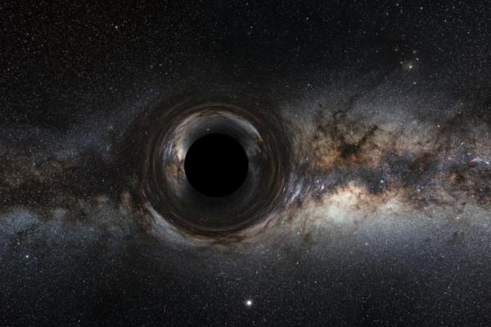

Estimating Hamiltonian in a 3+0 Schwarzchild Metric with Quantum Computers Using VQE Algorithm
Çağıl Benibol
Advisor: Osman Barış Malcıoğlu
Department of Physics

Slide 2


Contents
Abstract
Introduction​
Quantum Computers
Qubit
Scwarzchild Black-Hole
Schwarzchild Metric
Variational Principle
Methods
Results and Discussion
Acknowledgements
Bibliography

Slide 3
Abstract & Brief Explanation
The topic that I finalize my project is using in black-hole metrics. What interesting is near in Schwarzchild radius wave function vanishes to zero. Which arises some questions like ‘Is quantum mechanics reversable?’ and ‘Can an information be destroyed?’. In this work VQE may help us to see the relations between radius and energy. [1,3]
The advances on quantum computers are increasing rapidly. Algorithms on these computers are logarithmically faster. In order to catch this era of computing we need to understand the algorithms of the quantum information. Via using quantum information algorithms it is possible to make simulations to a given Hamiltonian that we are looking for.[1,2]
Estimating Hamiltonian in a 3+0 Schwarzchild Metric with Quantum Computers Using VQE Algorithm
2022

Slide 4
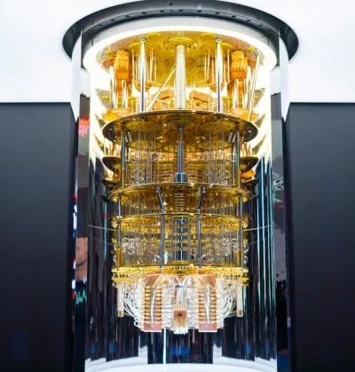
Introduction
What is quantum computing?
Quantum computers have far different architecture than the classical computers. In quantum computers we make circuit designs to execute our programs. These circuits are consisting of both classical registers and quantum registers. In other words, we use qubits (quantum bits) in our logic designs. [4]
The image retrieved from IBMQ

Slide 5
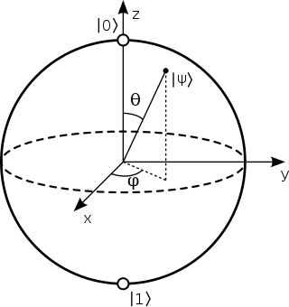
Introduction
What is Qubit?
Qubits uses quantum phenomena of superposition and entanglement which gives quantum computers superior advantage when it compared with classical computer. It natively shows linear combination of states which spans in Hilbert Space. [4]
Fig1. Bloch Sphere Representation of Qubit

Slide 6
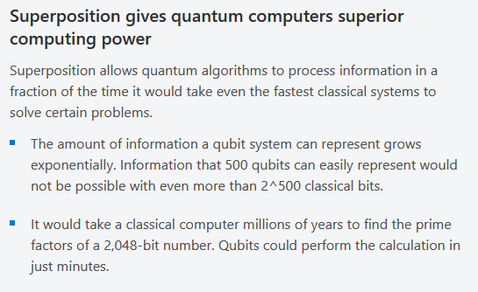
Introductıon
Fig2. Advantages of Quantum Computers with given examples by Microsoft Azure
Estimatıng Hamiltonian in a 3+0 Schwarzchild Metric with Quantum Computers Using VQE Algorithm

Slide 7


Schwarzchild Black-hole
Which describes non-rotating Black-Holes
Space-time curvature becomes infinite at r=0
Time-dilation effects becomes infinite on the spherical surface of event horizon.
The Schwarzchild Radius (event horizon) is
$R=2GM/c^{2}$ [6]
Estimatıng Hamiltonian in a 3+0 Schwarzchild Metric with Quantum Computers Using VQE Algorithm
2022

Slide 8




Schwarzchild Metric
This metric is an exact solution to the Einstein’s Field Equations that explains the gravitational field caused by a spherical mass. [3]
Estimatıng Hamiltonian in a 3+0 Schwarzchild Metric with Quantum Computers Using VQE Algorithm
2022

Slide 9


Final Hamiltonian That we want to deal with:
Free particle
The equations are retrieved from Kohli’s article [3]
Estimatıng Hamiltonian in a 3+0 Schwarzchild Metric with Quantum Computers Using VQE Algorithm
2022

Slide 10
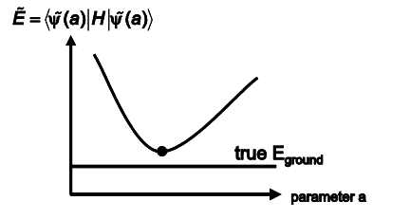

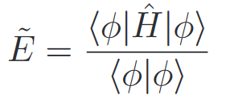
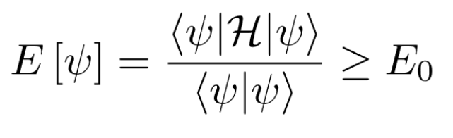
The Variational Principle
The solution of Scrödinger’s equation as follows,
The energy eigen values can be found by looking expectation values by given ansatzes,
When the ansatzes changes the energy eigen values are changing up to the minimum value of Ground State eigen value. Hence, If we minimize the graph of Eigenvalue vs the parameter in the ansatz wave function, we obtain the energy eigen values. [5,7]
Fig3. Eigenvalues vs Ansatz’s Parameter
Fig4. The inequality that indicates the minimum value is the Ground State value

Slide 11
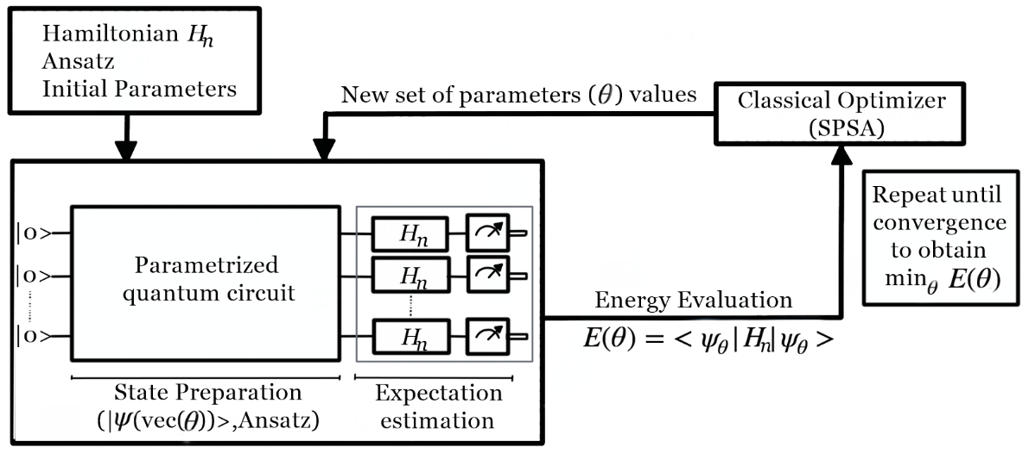
Methodology
Variational Quantum Eigensolver (VQE)
SLSQP & SPSA
Fig5. VQE algorithm diagram

Slide 12
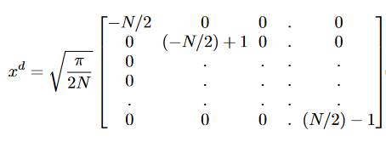
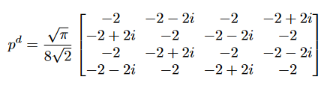

Methodology
Variational Quantum Eigensolver (VQE)
The position basis is used for Hamiltonian

Slide 13
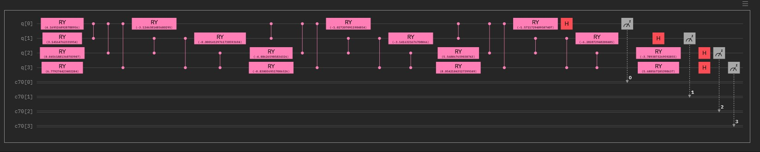


Methodology
Variational Quantum Eigensolver (VQE)
Decomposing Hamiltonian
In order to use VQE algorithm in IBM Qiskit we need to decompose Hamiltonian into Pauli Matrices. For 4 qubit example,
$$C_{μ,ν,λ,θ}=\frac{1}{16}tr(\sum{H⊗σ_{μ} ⊗σ_{ν} ⊗σ_{λ} ⊗σ_{θ})}$$
$H= \sum{C_{μ,ν,λ,θ}}∗σ_{μ}$ $⊗σ_{ν}$ $⊗σ_{λ}$ $⊗σ_{θ}$
$$where μ,ν,λ,θ=X, Y,Z,I$$
Fig6. VQE algorithm 4 qubit logic design created via Qiskit for harmonic oscillator

Slide 14
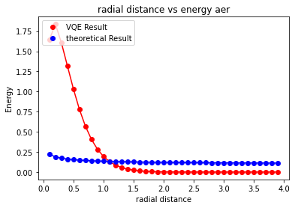
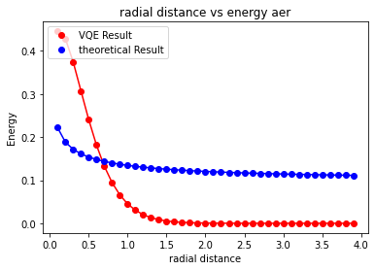
Results
Fig6. Aer Simulator values with SLSQP and SPSA optimizers (Left to Right)

Slide 15

Discussion
In this project we use different ansatz and different optimizers. Results show us that there are some deviations in VQE when the radial distances become smaller than 1 and we can relatively see ${\text{E}\text{ = }\text{a}\text{(}\text{b}\text{ + }\text{c}\text{/}\text{r}\text{)}}^{1/4}$ relation when we have done the fitting with 5 solar mass. (a= 0.808, b=-0.065 , c=0.255)
Different structure of ansatz can be used to improve this work which can be seen on the 1st reference.
For source codes: https://github.com/Tihulu/400-Project-Cagil-Benibol

Slide 16
Acknowledgements
Special thanks to Osman Barış Malcıoğlu for encouraging me and helping me during the whole semester for this project and my mental health, Sadi Turgut for helping me to decompose Hamiltonian Matrix into Pauli Matrices, Bayram Tekin for helping me to understand the meaning of Energy eigenvalues when we try to simulate different kind of potential systems.

Slide 17
Bibliography
[1] Quantum Simulation of Hawking Radiation Using VQE Algorithm on IBM Quantum Computer, Dhaulakhandi, R., Behera, B. K., https://arxiv.org/pdf/2112.15508.pdf
[2] Quantum Computing for Inflationary, Dark Energy and Dark matter Cosmology, Joseph, A. et al., https://arxiv.org/pdf/2105.13849.pdf
[3] QUANTUM WAVEFUNCTION IN A SCHWARZSCHILD SPACETIME, I.S. Kohli, https://arxiv.org/pdf/1110.6204.pdf
[4] What is a qubit, https://azure.microsoft.com/en-us/overview/what-is-a-qubit/#introduction
[5]Lecture I: The Variational Principle Toffoli, H. http://www.physics.metu.edu.tr/~hande/teaching/741-lectures/lecture-01.pdf
[6] Schwarzschild Black Holes, Mushotzky, R. https://www.astro.umd.edu/~richard/ASTRO350/Astro350_2020_class08.pdf
[6] Variational Methods , https://courses.physics.illinois.edu/phys485/fa2015/web/variational.pdf

Slide 18
Thank you
Çağıl Benibol
cagil.benibol@gmail.com
cagilbenibol.com
https://github.com/Tihulu

